Slide 1
Retail Rocket eCommerce
Online Shopping Behavior Modelling
& Recommendation System
Maggie Han
Apr. 14, 2023

Slide 2
CONTENTS
Retail Rocket eCommerce Introduction
Dataset and Objective
Exploratory Data Analysis
Model 1: Recommendation Model
Model 2: Regression Model
Business Insights

Slide 3
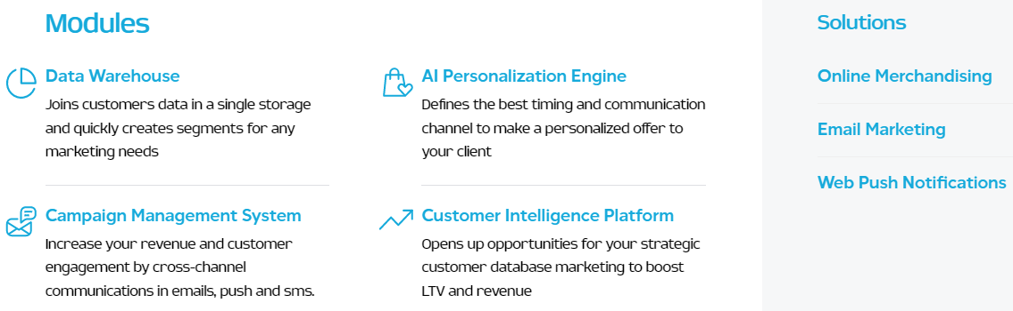
Retail Rocket eCommerce Introduction
Developer of a predictive analytics platform
Designed to help organizations identify the needs of web shop users by analyzing behavior.
Leverage big data for determining the needs of visitors
Provide organizations personalized offers to customers
Aim to help retailers ultimately increase conversion rate, average order value, retention rate.

Slide 4
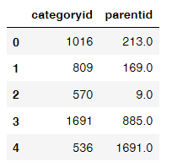
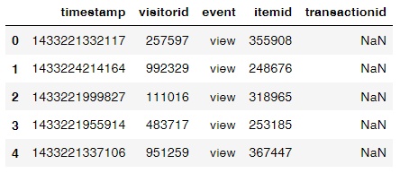
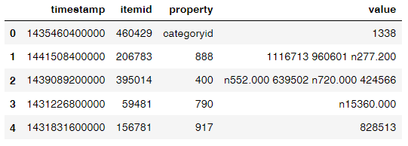
2. Dataset and Objective
Original Dataset:
Objective:
Contains 3 csv files: Category tree, Events, Item property
The timestamp is in Unix Epoch format
Property : category id , availability, while the rest are hashed for confidentiality purposes
Try to build a recommendation system using both collaborative filtering and content based recommender.
Do thoroughly exploratory data analysis to familiar with the dataset, and try to transform it to a new dataset that works for a classification or regression model.
To understand, validate, and interpret the model and provide the business insights.

Slide 5
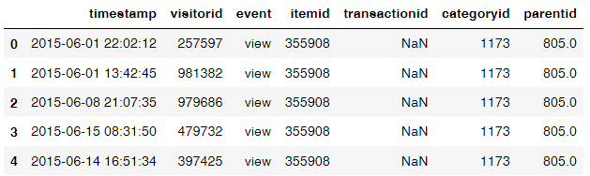
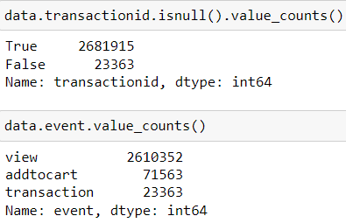
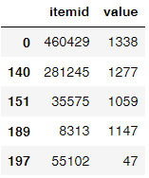
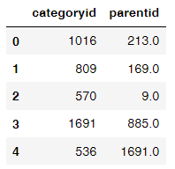
3. Exploratory data analysis
Rows: 2705278
Unique items: 235061
Unique visitors: 1407580
Total visitors: 2756101
Visitors that made purchase: 11719
Visitors that only browse: 1395861
Concat 3 tables:
Concat event and item table using the same itemid

Slide 6
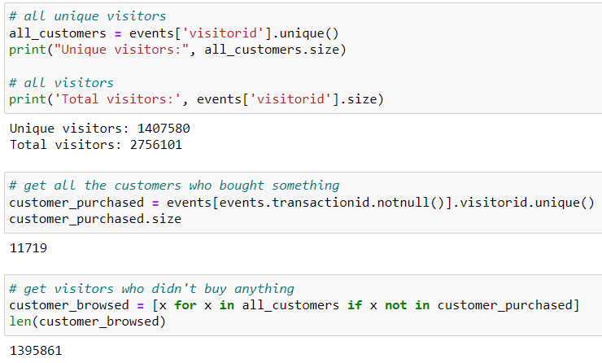
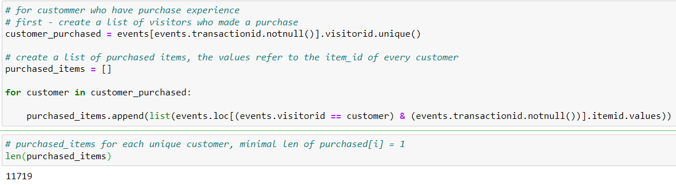
4. Recommendation Model
Logics for item-item based recommendation system:
Collaborative filtering
find the customer who made purchase
find their purchased items
define a function to return a list of same item in purchase
Content based recommender
add similar products that in the same category or same parentid with top purchase frequency to the list

Slide 7
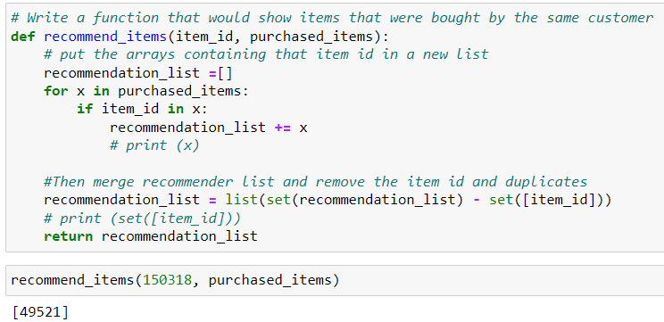
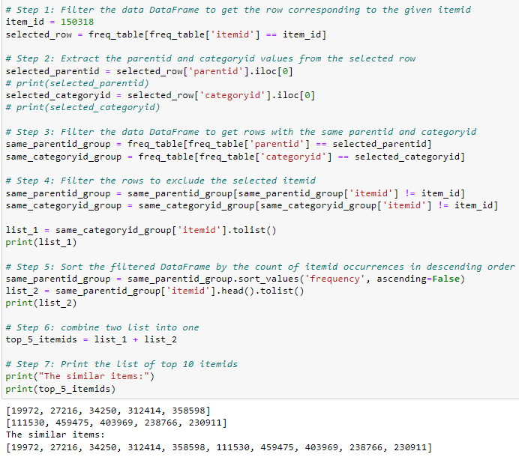
4. Recommendation Model

Slide 8
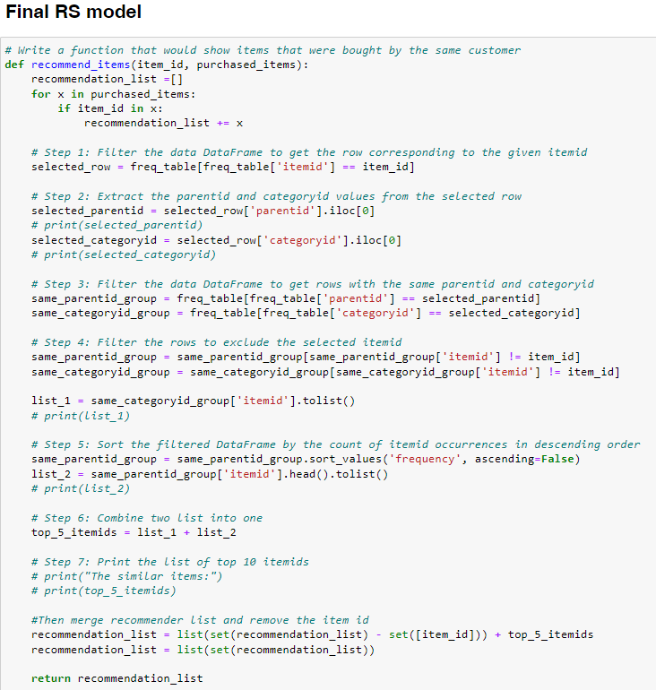
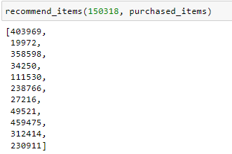
Build a RS by searching for matches, instead of using similarity.
Initially create a pivot table for customid as row, itemid as column, and event as the content.
Need to think about how to build similarity after filtering that event = ‘transaction’
How to evaluate the RS model without similarity score?

Slide 9
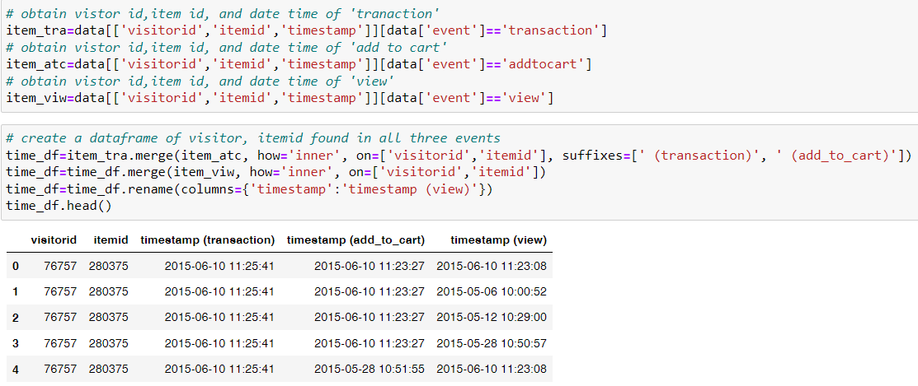
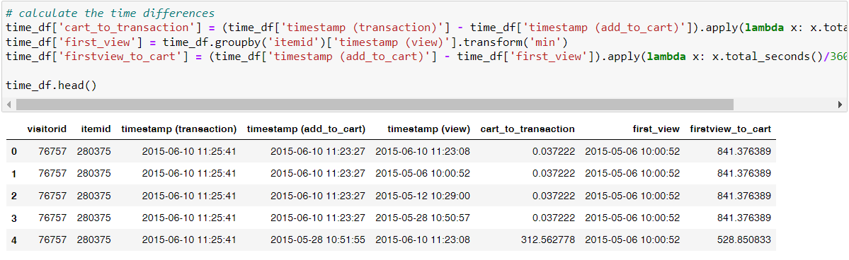
5. Regression Model
Timestamp:
Notes:
To further understand the customer’s purchase behavior, deeper EDA is required.

Slide 10
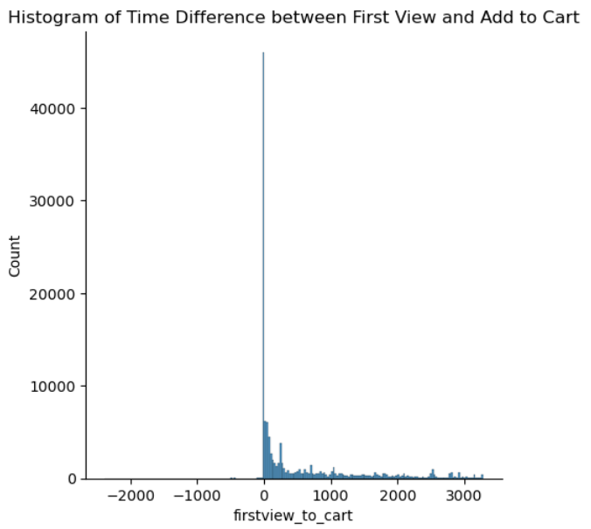
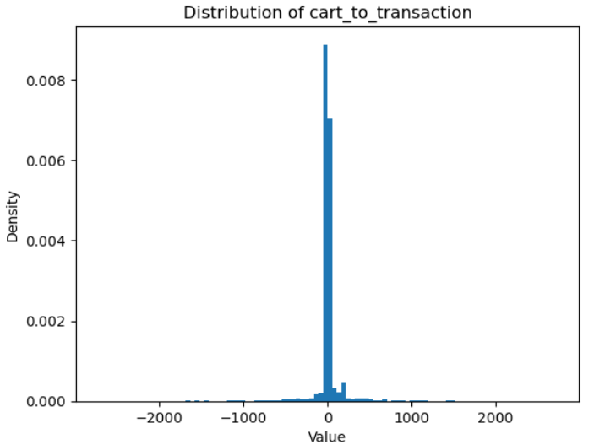
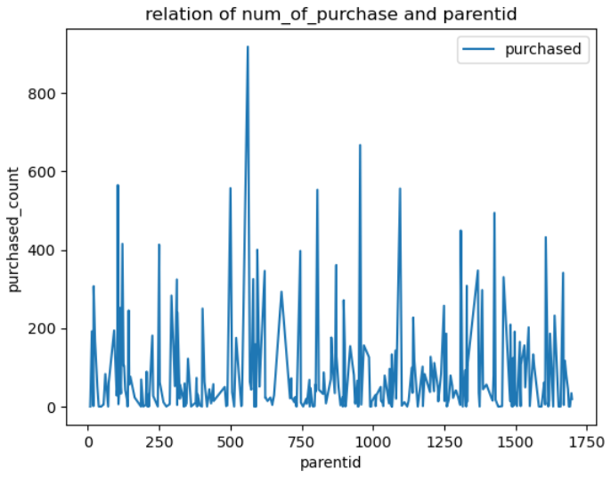
5.1 EDA of the original dataset
Original Dataset:

Slide 11
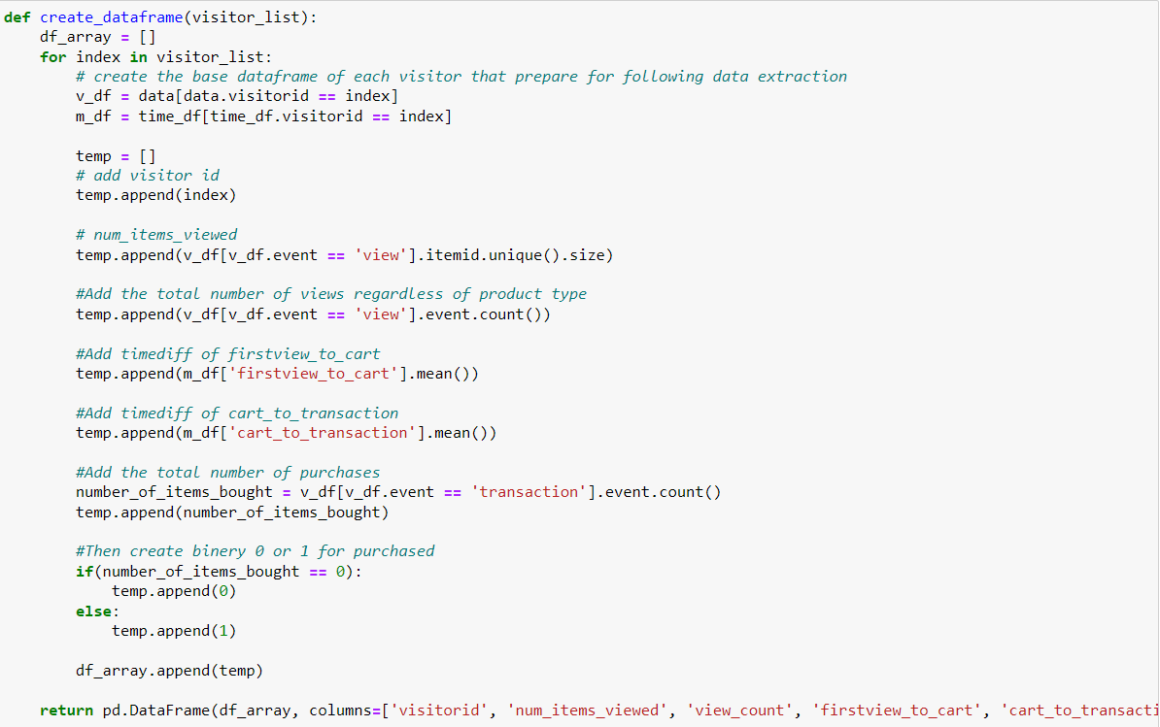
5.2 Build new dataset
Goal: predict purchase or not, purchase ability

Slide 12
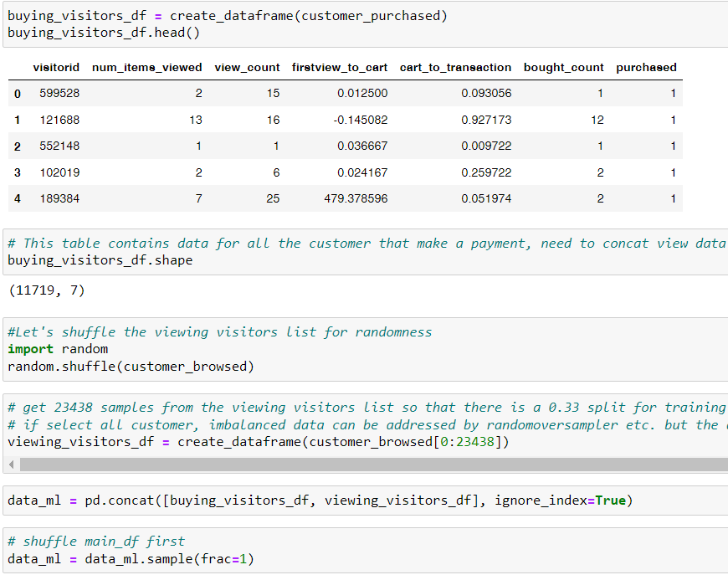
5.2 Build new dataset
column item | means
visitorid | unique visitorid
num_items _viewed | How many items one customer viewed
View_count | How many times one customer view online regardless items
firstview_to_cart | Timediff between firstview and addtocart, mean of all the items
cart_to_transaction | Timediff between addtocart and transaction, mean of all the items
Bought_count | Total number of purchase
purchased | 0 or 1 (binery)

Slide 13
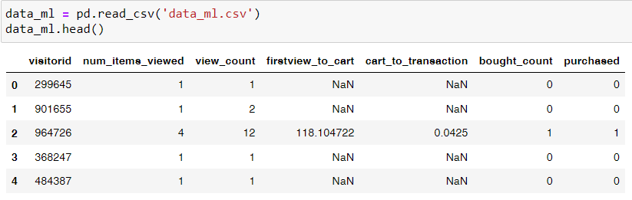
5.3 Dataset for modelling
view_rate = num_items_viewed / view_count
total viewed items number / total view number
lower view_rate refer to that the customer focus on a specific item
purchase_rate = bought_count / view_count
the total purchase items number / total view number
The higher purchase_rate, the higher purchase ability

Slide 14
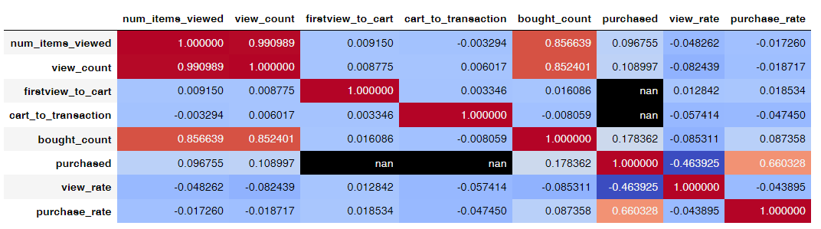
5.3 Dataset for modelling
For label selection, the columns need to be dropped as follow:
purchased | Purchase_rate
View_count | View_count
Firstview_to_cart (no relation to label) | Purchased
Cart_to_transaction(no relation to label)
Purchase rate

Slide 15
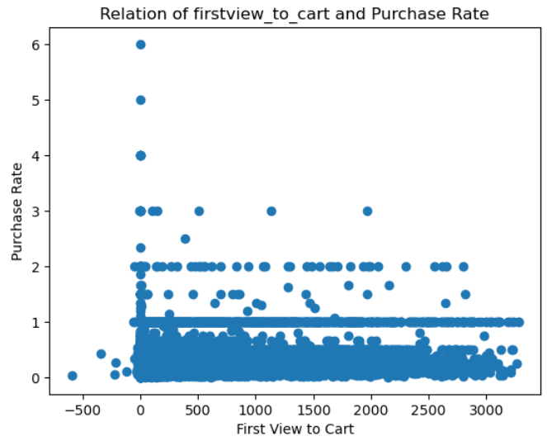
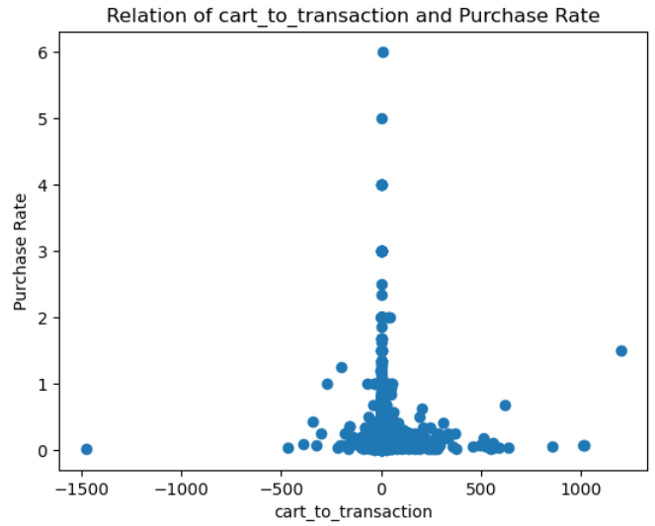
5.4 EDA of modelling dataset
How to address the missing value?
Current strategy: Using SimpleImputer to fill a constant value

Slide 16
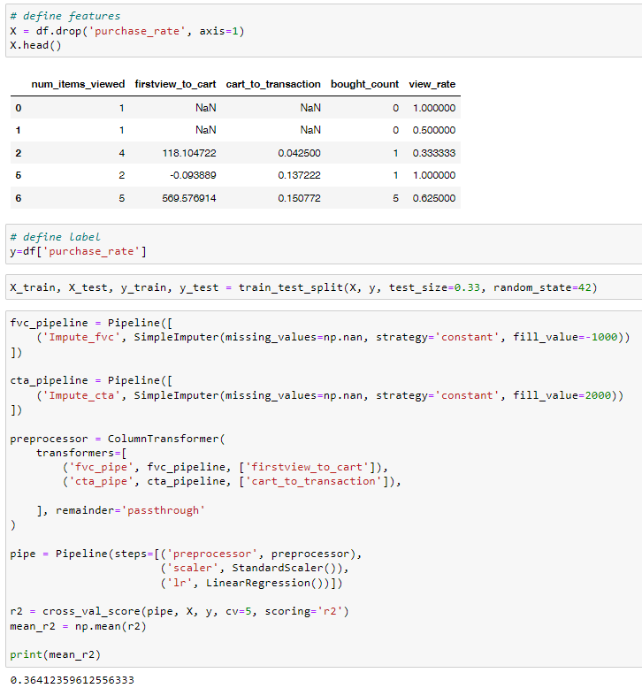
5.5 Baseline Model
Baseline model: LinearRegression
Score: r2
MSE is the average squared difference between the predicted values and the actual values.
R2 is a measure of how well the regression model explains the variability in the data, range from 0 to 1.
1 indicate that a larger proportion of the variability in the dependent variable is explained by the model,
0 indicate that the model explains little of the variability in the data.

Slide 17



5.6 Model selection
Model | R2 score | Performance
Linear Regression | 0.36412359612556333
Polynomial Regression (degree=2) | 0.43741591439839744
RandomForestRegressor | 0.9905020649195226
XGBoostRegressor | 0.9936030937168236
XGBRFRegressor | 0.972974771905557
Neural Network | 0.6907307768211305
Neural Network with hyperparameter tuning | 0.8334061193263528
Stacking of LR, RF, XGBoost | 0.9906049860878501
Non-linearity relationship of features and label:
Linear regression assumes a linear relationship between the dependent and independent variables. If the true relationship between the variables is non-linear, then linear regression may not be able to capture the underlying patterns accurately.
RandomForest and XGBoost are capable of capturing non-linear relationships between variables.

Slide 18
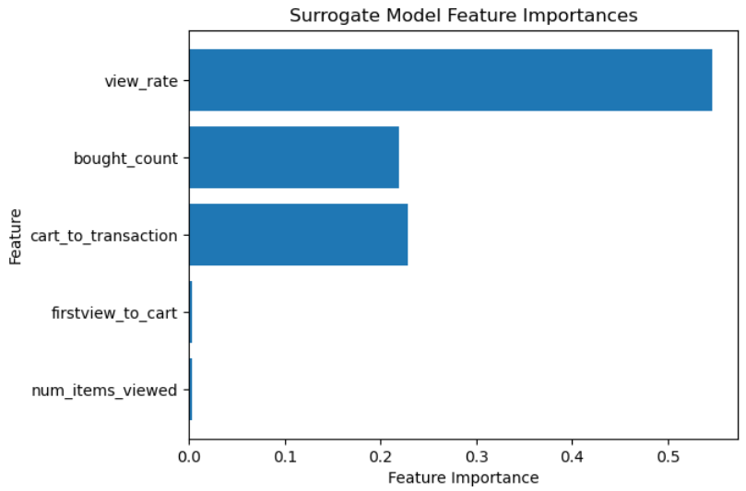
5.7 Surrogate and Permutation
Surrogate:
Permutation:
The feature importance in a surrogate model is typically determined based on the number of times a feature is used for splitting in the surrogate decision tree.
The more frequently a feature is used for splitting, the higher its importance is considered to be.
The order of feature importance in the surrogate model may depend on the specific decision tree that was used to create the surrogate, and it may not necessarily reflect the true importance of features in the original complex model.
Weight | Feature
27.1245 ± 0.2626 | cart_to_transaction
25.8921 ± 2.2240 | bought_count
0.8136 ± 0.0388 | view_rate
0.0280 ± 0.0036 | firstview_to_cart
0.0061 ± 0.0011 | num_items_viewed
Black box model:
MLPRegressor
Surrogate model:
Decision Tree
The permutation importance is typically calculated as the decrease in model performance after permuting a feature, and it is ranked based on the magnitude of this decrease.
The order of feature importance in Permutation Importance is determined based on the calculated decrease in model performance for each feature, and it may reflect the true importance of features.

Slide 19
6. Business Insights and Feature Work
Business Insights
The feature importance from Permutation shows that the cart_to_transaction and bought_count are more important to predict a customer who has high possibility buying a product online.
In other words, the behavior of firstview_to_cart and num_items_viewed is implict while cart_to_transaction and bought_count are explict features.
For business purpose, maintain their regular customer or return customer would be important to keep even increase the order value.
Feature Work
Improve the recommender system using similarity.
Check other imputing method for missing values in firstview_to_cart and cart_to_transaction.
Play with neural network neuron number, layers and hyperparameters to see if it can achieve better results for this small size dataset.

Slide 20
The end. Thanks for attention.

